Slide 1
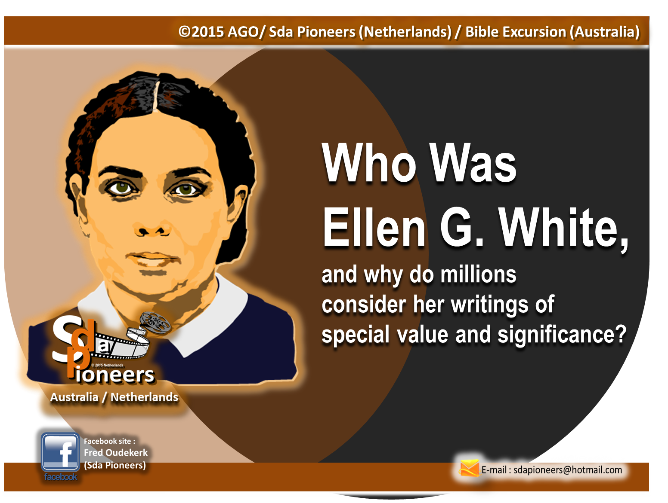
PART 1

Slide 2
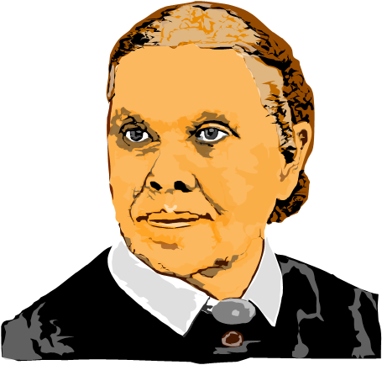


In brief, she was a woman of remarkable spiritual gifts who lived most of her life during
the nineteenth century
(1827-1915),
yet through her writings she is still making a revolutionary impact on millions of people around the world.
Ellen G. White
(1827-1915)

Slide 3

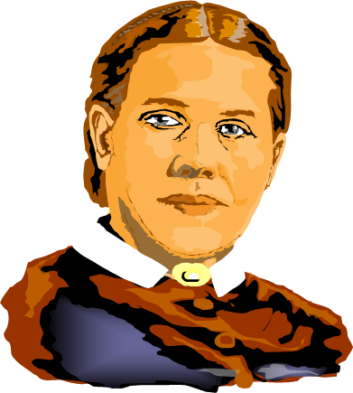
During her lifetime she wrote more than 5,000 periodical articles and 40 books; but today, including compilations from her 50,000 pages of manuscript, more than 100 titles are available in English.

Slide 4
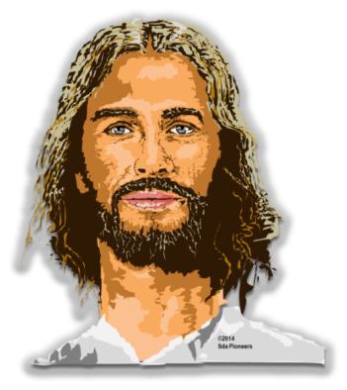

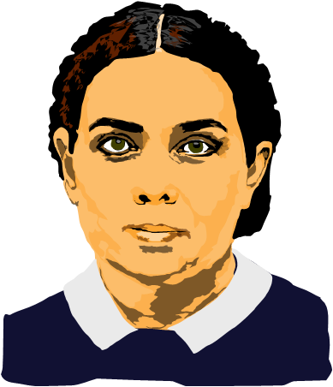

Seventh-Day Adventists believe that Mrs. White was more than a gifted writer; they believe she was appointed by God as a special messenger
to draw the world's attention
to the Holy Scriptures and help prepare people for Christ's second advent.

Slide 5
The Early Years
Ellen G. White
(1827-1915)

Slide 6
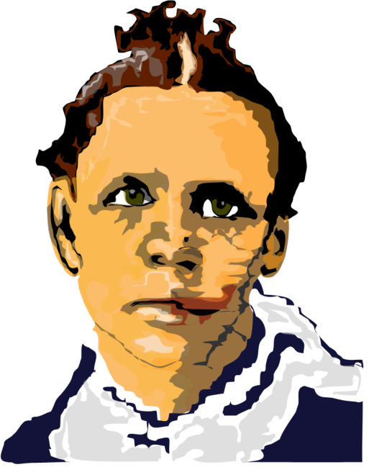
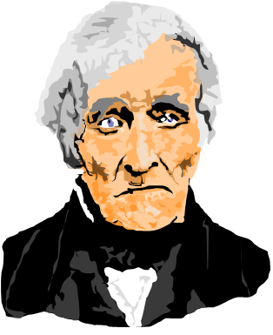
Ellen, with her twin sister Elizabeth, was born
November 26, 1827,
to Robert and Eunice Harmon.
Robert Harmon

Slide 7
At the age of nine (1836), while returning home from school one afternoon, she was severely injured in the face by a stone thrown by a classmate. For three weeks
she was unconscious, and in the years that followed she suffered greatly as a result
of the serious injury to her nose. Ellen's formal education ended abruptly, and it seemed to all that the formerly promising little girl could not live long.

Slide 8
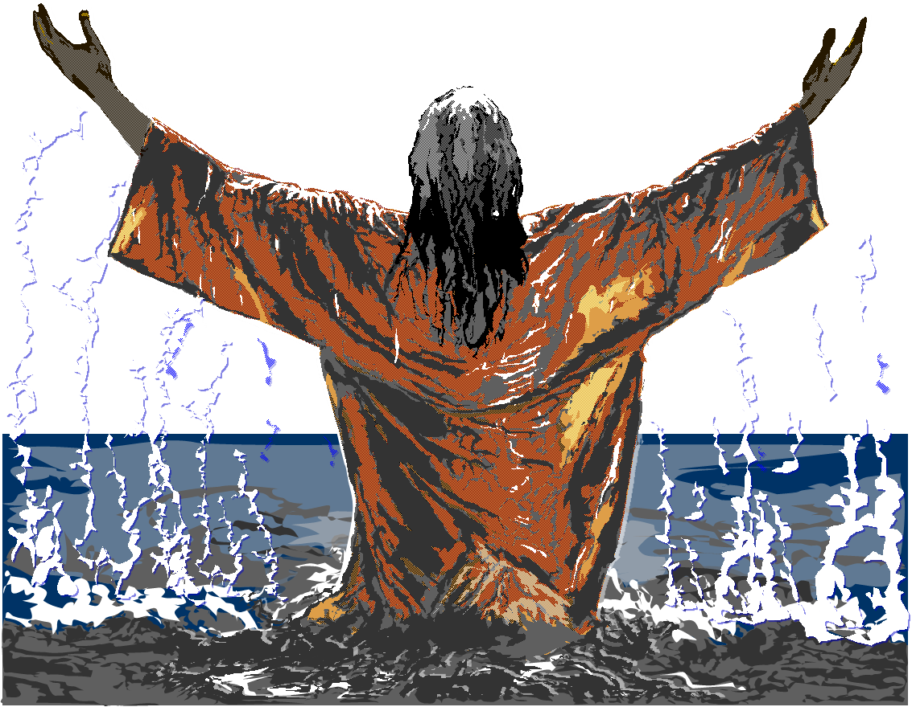
On June 26, 1842,
at her request she was
baptized by immersion
in Casco Bay, Portland.
That same day
she was received
as a member
of the Methodist Church.

Slide 9
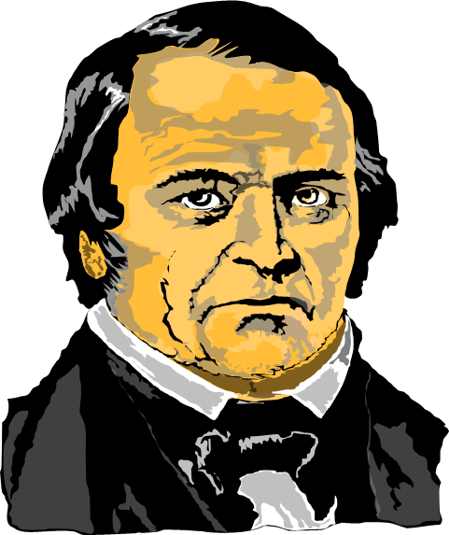
The Advent Message
William Miller
(1782-1849)

Slide 10
In 1840 and 1842 Ellen, with other members of the family, attended Adventist meetings in Portland, accepted the views presented
by William Miller and his associates,
and confidently looked for Christ's imminent return. Ellen was an earnest missionary worker, seeking to win
her youthful friends and doing her
part in heralding the Advent Message.
William Miller
(1782-1849)

Slide 11
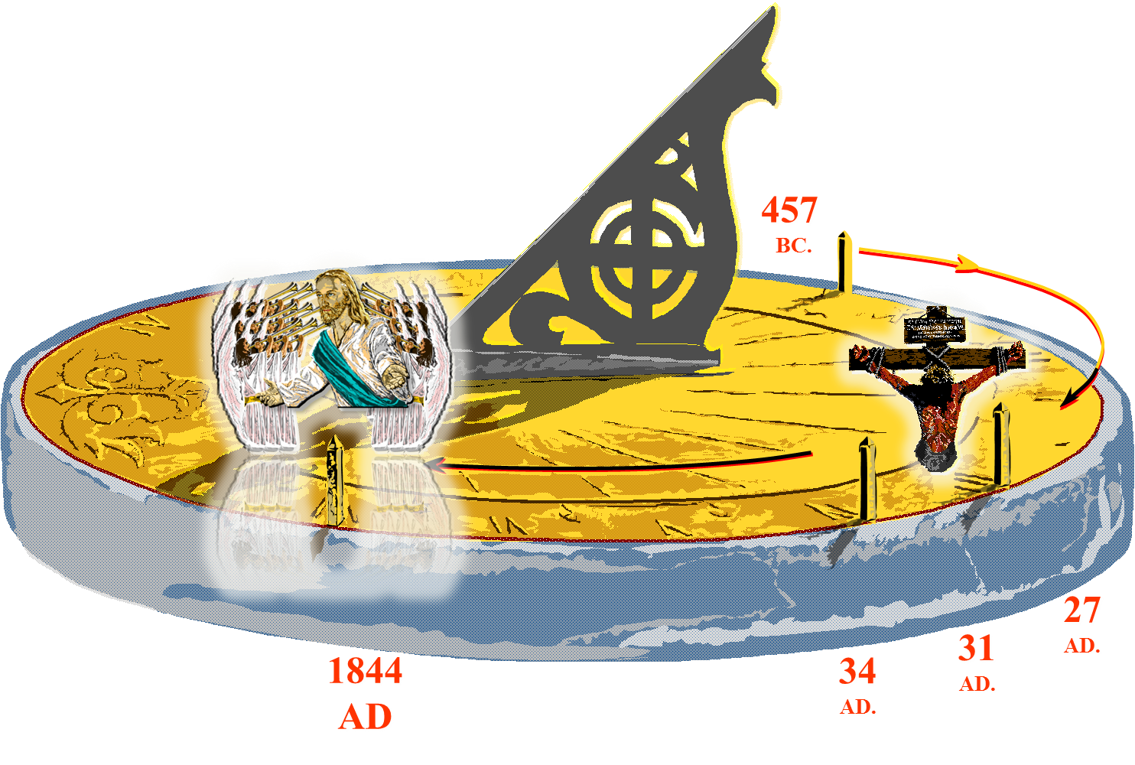
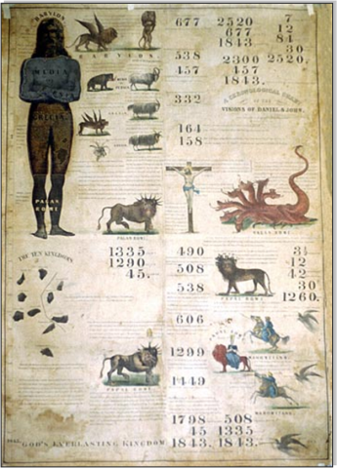
The keenness of the Great Disappointment that Jesus did not return to earth on October 22, 1844 was not lessened by Ellen's youth, and she, with others, studied the Bible and prayed earnestly for light and guidance in
the succeeding days of perplexity.
William Miller
(1782-1849)

Slide 12
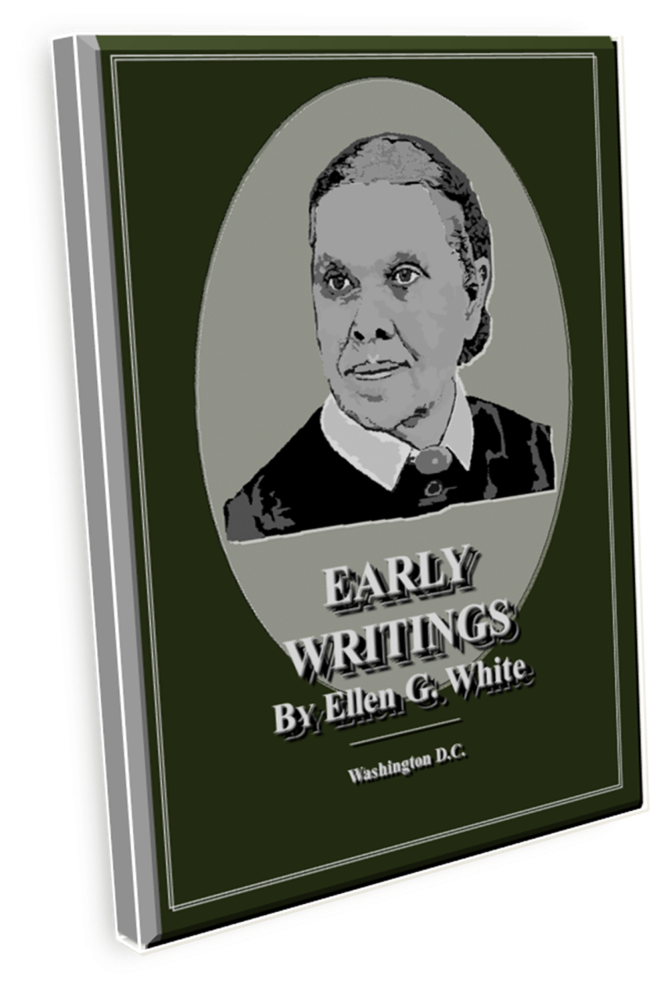
When many were wavering or were abandoning their Adventist experience, Ellen Harmon, one morning late in December, joined four other women in family worship at the home of a fellow believer in South Portland. Heaven seemed near to the praying group, and as the power of God rested on Ellen she witnessed in vision the travels of
the Advent people to the City of God.
Early Writings pp. 13-20 ;
Ellen G. White

Slide 13
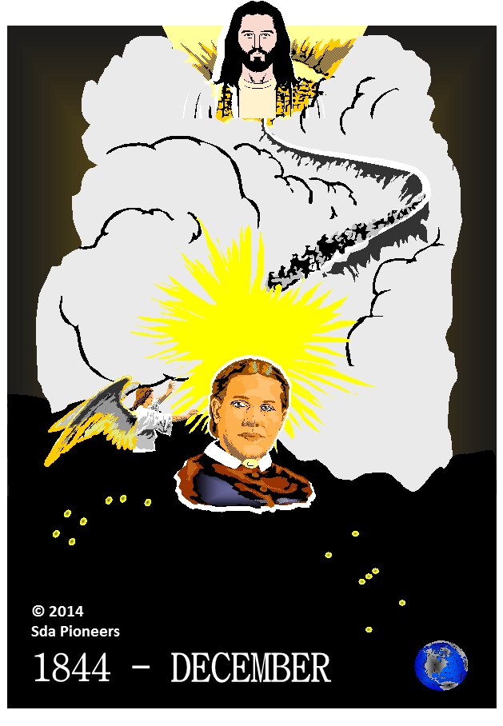
FIRST VISION
In this vision the “Advent people” were traveling a high and dangerous path towards the city of New Jerusalem [heaven]. Their path was lit from behind by "a bright (light)...which an angel told me was the Midnight Cry. “Some of the travelers grew weary and were encouraged by Jesus; others denied the light, the light behind them went out, and they fell "off the path into the dark and wicked world below.”

Slide 14
FIRST VISION
The vision continued with a portrayal of Christ’s Second Coming, following which the Advent people entered the New Jerusalem; and ended with her returning to earth feeling lonely, desolate and longing for that “better world”.

Slide 15
END OF PART 1

