Slide 1
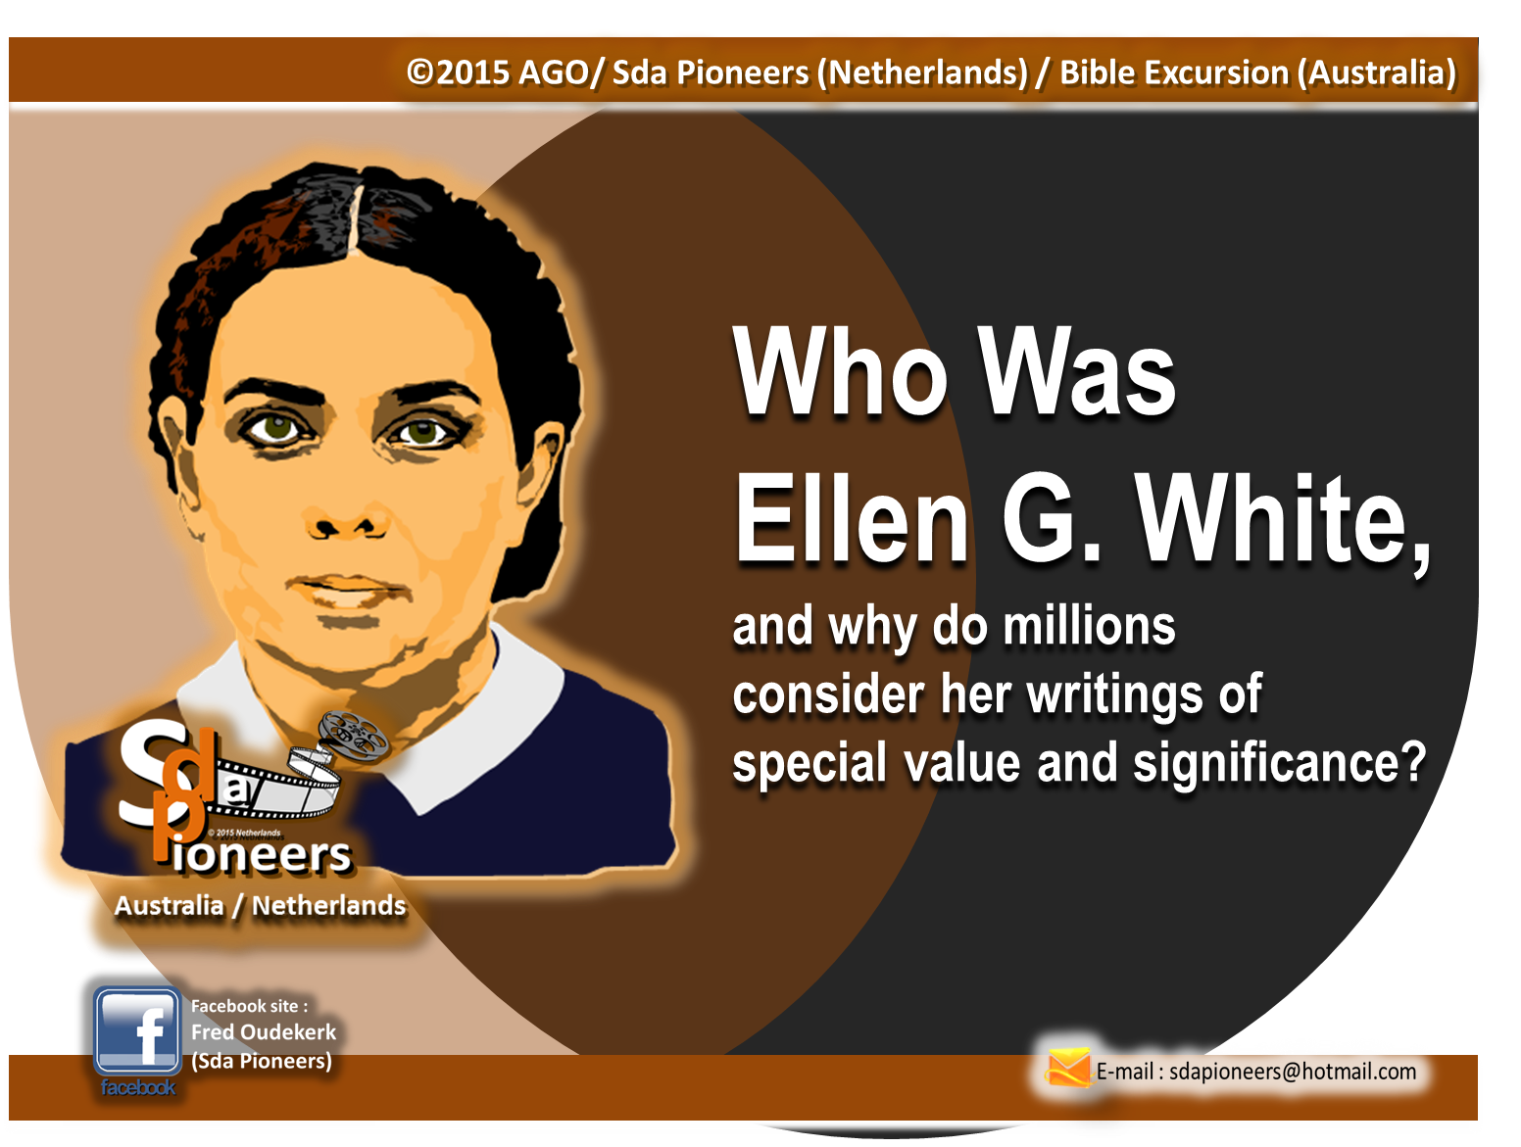
PART 2

Slide 2
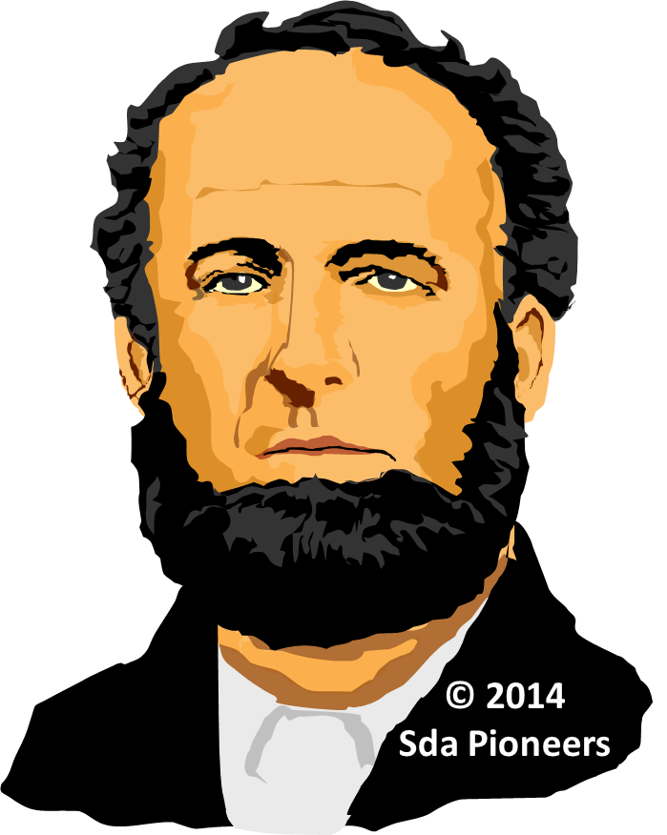



Marriage of James White and Ellen Harmon

Slide 3
On a trip to Orrington, Maine, Ellen met a young Adventist preacher, James White,
then 23 years of age.
As their labors occasionally brought the two together,
there sprang up an affection that led to their being united in marriage late in August, 1846.
James S. White

Slide 4



During the first few weeks following their marriage,
James and Ellen
gave earnest study
to a 46-page tract published
by Joseph Bates,
in New Bedford,
Massachusetts.

Slide 5
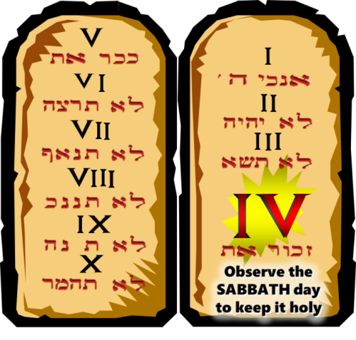
The tract, entitled
Seventh-day Sabbath, set
forth the Biblical evidence
for the sacredness of the Seventh Day. Convinced
that the views set forth
were scriptural, they
began to keep Saturday
as the Sabbath.

Slide 6
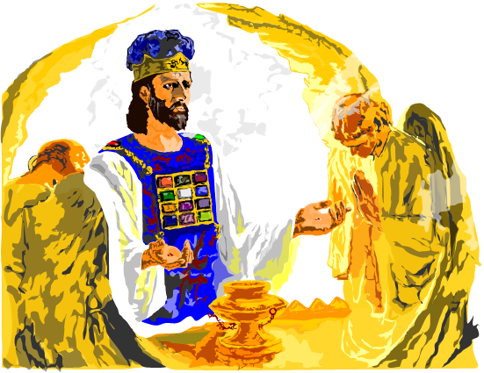
Some six months later,
on April 3, 1847, Ellen White was shown in vision the law of God in the heavenly sanctuary,
with a halo of light around
the fourth commandment.
This view brought a clearer understanding of the importance of the Sabbath doctrine, and confirmed the confidence of
the Adventists in it.
Early Writings pp. 32-35 ;
Ellen G. White

Slide 7

A son, Henry, was born to the Whites on August 26, 1847. His presence brought joy and comfort
to the young mother, but Ellen White soon found she must leave her child with trusted friends and continue her work in traveling and bearing the messages God had entrusted to her.
Henry Nichols
White

Slide 8
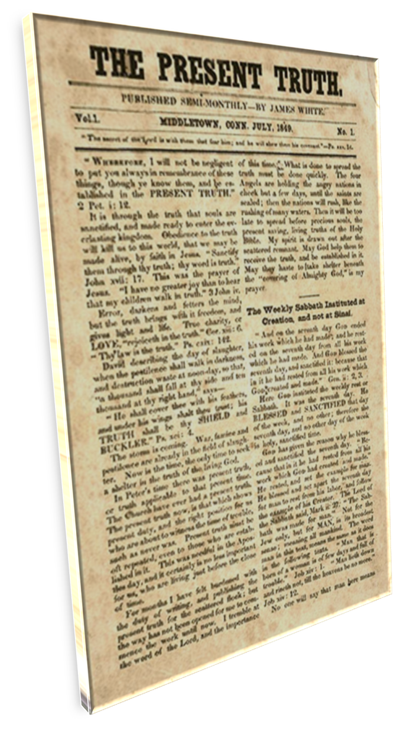

Beginning to Publish

Slide 9
While at Rocky Hill, Connecticut, in the summer of 1849, James White began publication of
The Present Truth,
an eight-page semimonthly paper. The later numbers
carried articles from Ellen White’s pen setting forth prophetic views of the future
of the church and
sounding notes
of warning and counsel.

Slide 10
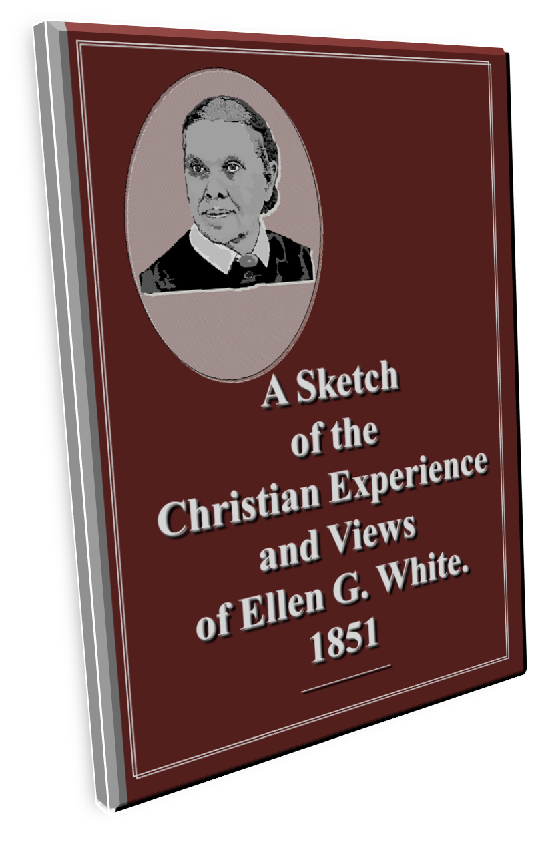
The year 1851 marked the appearance of Mrs. White’s first book, a paper-covered work
of 64 pages entitled, A Sketch
of the Christian Experience
and Views of Ellen G. White.
This early document and
its Supplement (1854)
are now found on pages 11-127
of the book Early Writings.

Slide 11
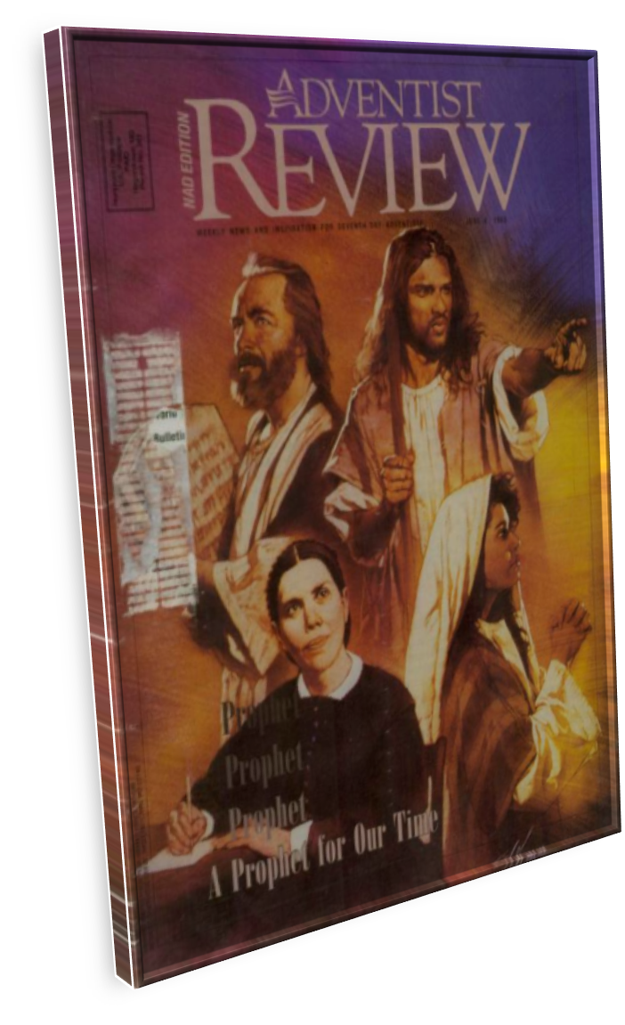
The days of the beginning of the Review and Herald in 1850 and the Youth’s Instructor in 1852, the securing of a hand press, then the publishing of the papers in Rochester, New York,
during the years 1852-1855,
were strenuous and trying.
Money was scarce. Sickness and bereavement played their part
in bringing distress and discouragement. But there
were brighter days ahead…

Slide 12
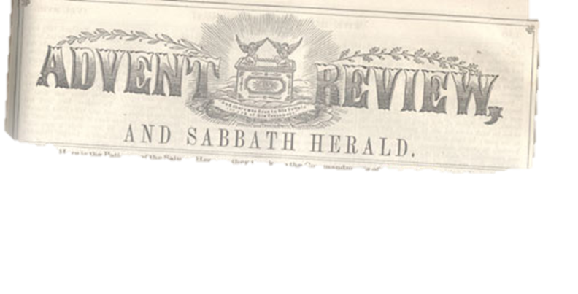
The Move to
Battle Creek

Slide 13
In November, 1855,
the Review and Herald Publishing Association,
with the hand press and other printing equipment,
was moved from rented quarters in Rochester, New York,
to the newly erected building
in Battle Creek, Michigan,
so liberally provided by
the Advent believers.
James S. White

Slide 14
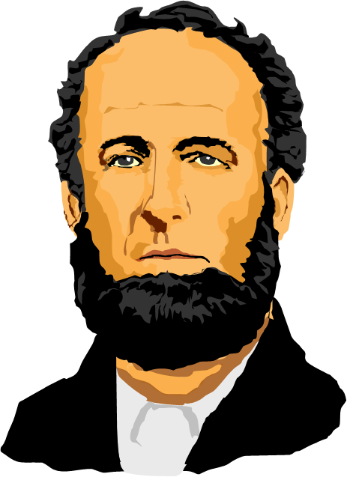
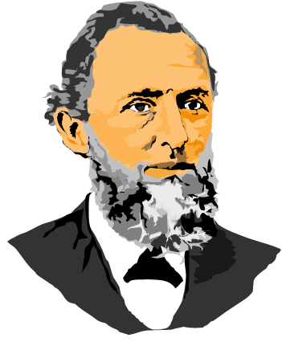

A few days (1855)
after Elder and Mrs. White,
and those associated
with them in the
publishing work,
arrived at Battle Creek,
a conference was held to consider plans for spreading
the Advent Message.

Slide 15

In due time there came from the re-established press
a 16-page tract bearing
the title,
Testimony for the Church (Testimonies, vol. 1,
pp. 113-126),
the first of a series of writings that in 55 years totaled nearly 5,000 pages, as published
in the Nine Volumes of
Testimonies for the Church.

Slide 16
END OF PART 2

