Slide 1
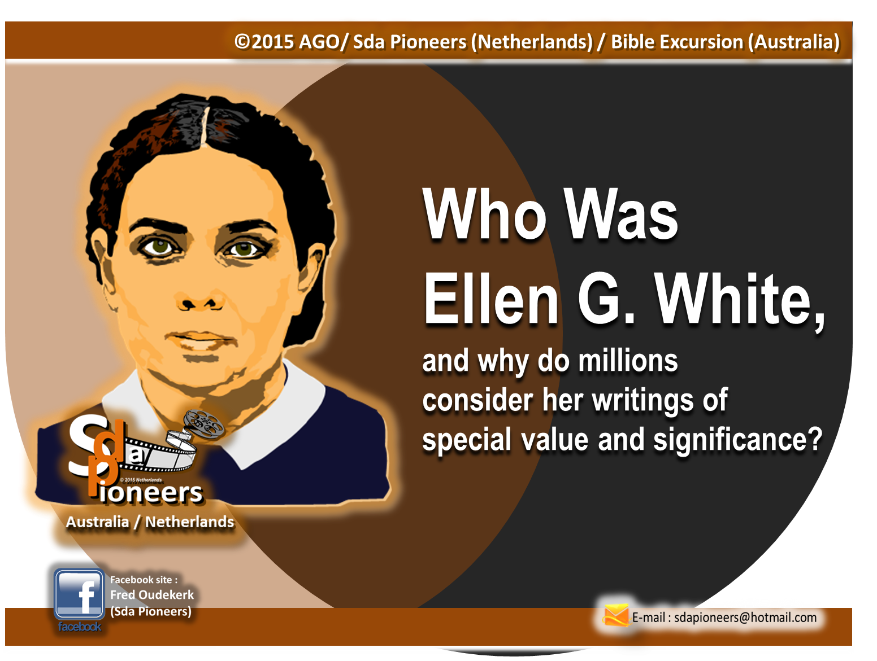
PART 3

Slide 2
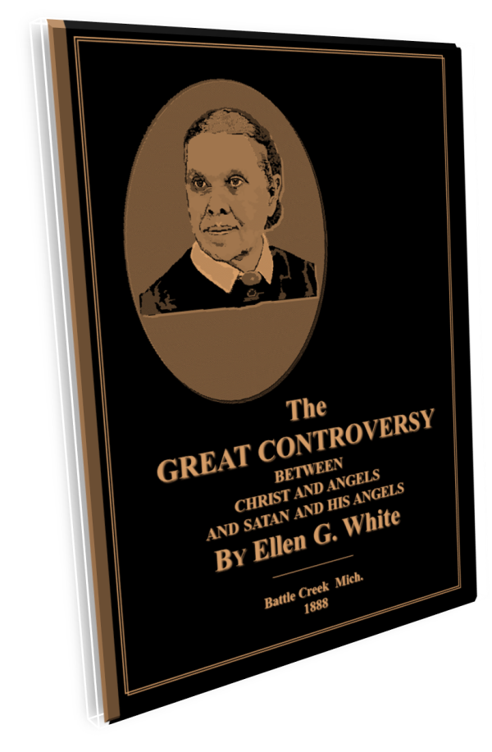



The
“Great Controversy”
Vision

Slide 3
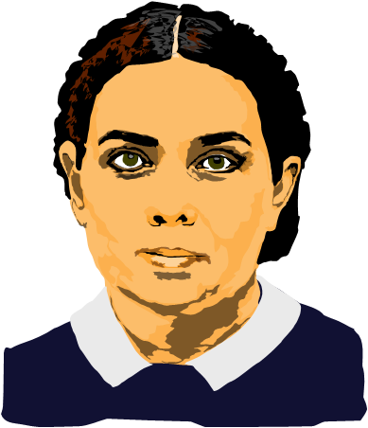
At an Ohio funeral service held on a Sunday afternoon in March, 1858, in the Lovett's Grove (now Bowling Green) public school, a vision of
the Ages-long Conflict between Christ and His angels and Satan and his angels
was given to Mrs. White.

Slide 4
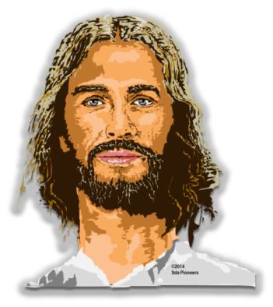
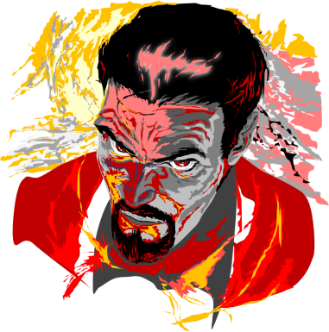
Two days later Satan attempted to take her life, that she might not present to others what had been revealed to her. Sustained, however, by God in doing the work entrusted
to her, she wrote out a description of the scenes that had been presented
to her, and the 219-page book
Spiritual Gifts, volume 1,
The Great Controversy Between Christ and His Angels and Satan
and His Angels, was published
in the summer of 1858.

Slide 5
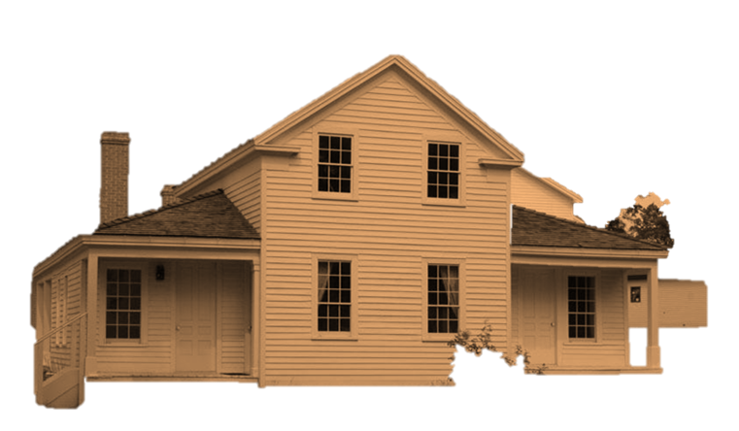
The Home
in
Battle Creek

Slide 6
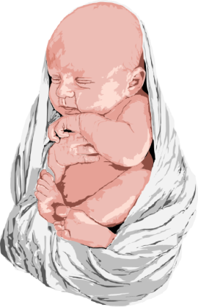
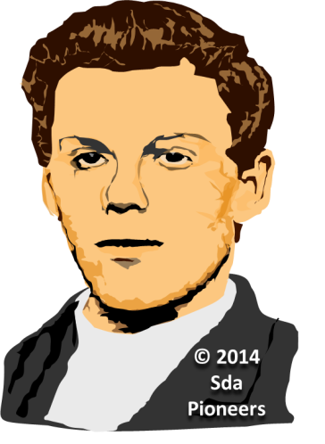
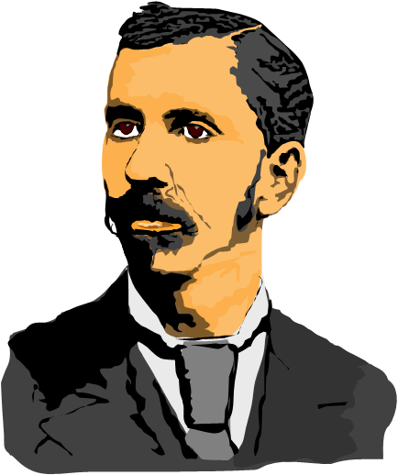
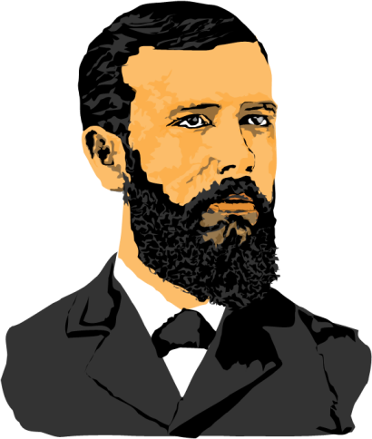
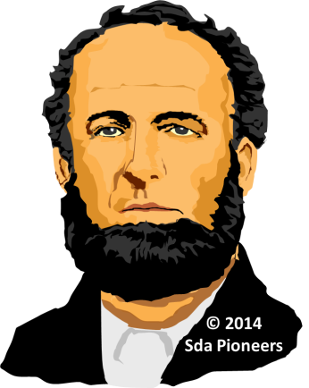
Herbert White
By the fall of 1860
the White family
numbered six,
with four boys ranging
from a few weeks
to 13 years of age.
The youngest child,
Herbert, however,
lived only a few months,
his death bringing
the first break in
the family circle.
Henry Nichols White
James Edson White
Willy C.
White

Slide 7
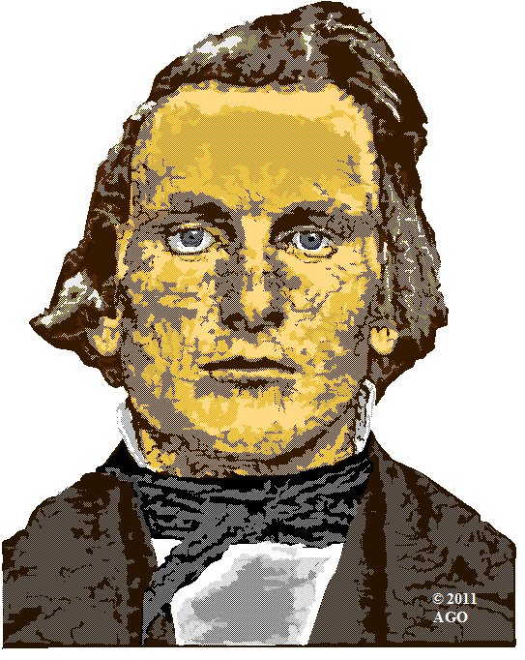
When church pioneers met in 1860
to name their movement…,
David Hewitt
introduced the name
"Seventh-Day Adventist"

Slide 8
The culminating efforts to establish church and conference organizations, with the demands for much writing, traveling,
and personal labor, occupied the early years of the 1860s.
The climax was reached
in the organization of
the General Conference
of Seventh-Day Adventists
in May, 1863.

Slide 9

The Health Reform Vision

Slide 10

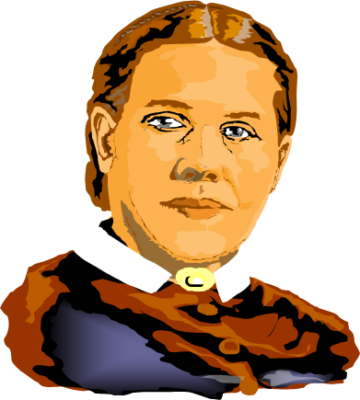
Ellen White was given a vision
of the relation of physical
health to spirituality, of the importance of following right principles in diet and in
the care of the body,
and of the benefits
of nature's remedies
--clean air,
sunshine, exercise,
and pure water.

Slide 11
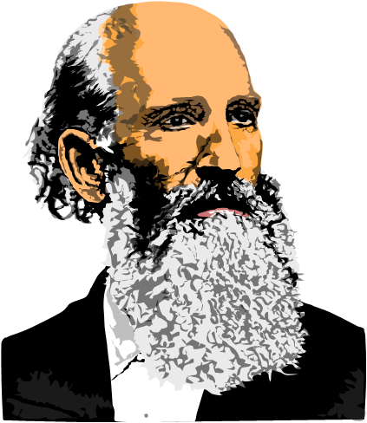
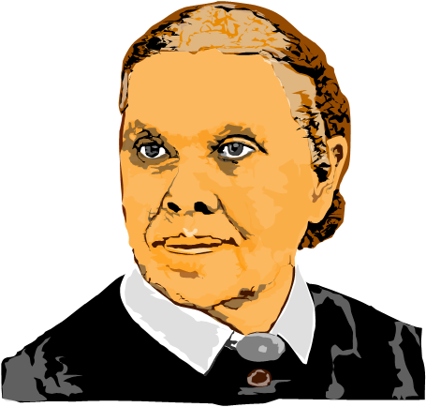
Death of James White

Slide 12
There were periods when
Elder White was in reasonable health and able to continue with his work. But his long years of mental and physical overwork had diminished his life forces, and he died in Battle Creek
on August 6, 1881.
James S. White
(1821-1881)

Slide 13

Ellen
White Visits Europe

Slide 14
For some time the General Conference had been asking Mrs. White and her son,
W. C. White, to visit
the European missions.
They spent the time from
the fall of 1885 to the summer
of 1887 in the European countries.

Slide 15
The Great Controversy
and
Patriarchs and Prophets

Slide 16
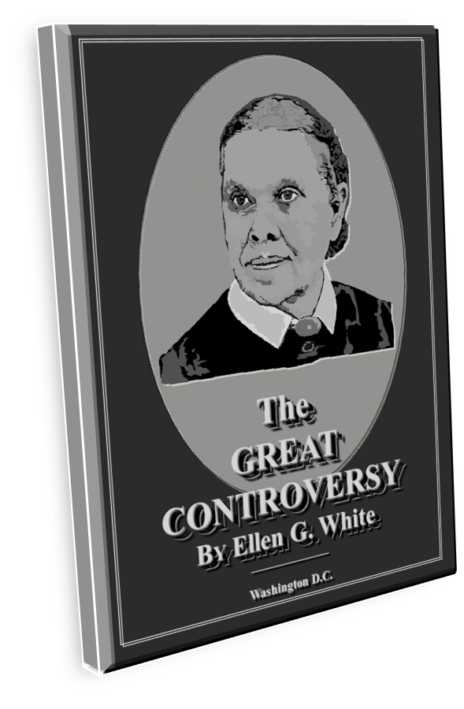
Ellen White felt she must
write out more fully
the controversy scenes…
The result was the book
known today as
The Great Controversy,
first published in 1888.

Slide 17
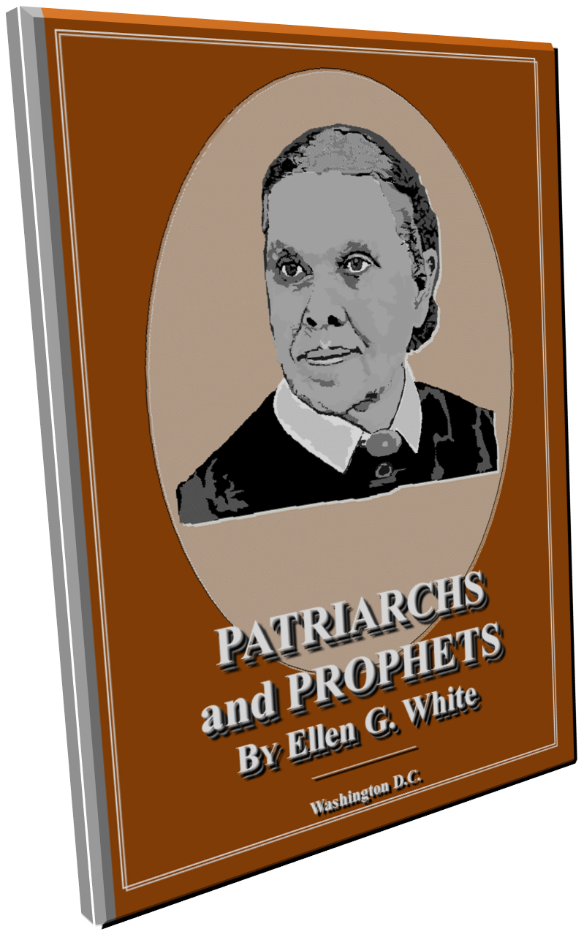
Ellen White felt she
must write out more fully
the controversy scenes…
The result was the book Patriarchs and Prophets,
which appeared in
the year 1890.

Slide 18

Called
to Australia

Slide 19
At the General Conference session of 1891, Mrs. White was presented with an urgent call to visit Australia to give counsel and assist in church work in that pioneer region. Responding to this appeal, she reached Australia in December, 1891, accompanied by her son, Elder W. C. White, and several of her assistants.

Slide 20
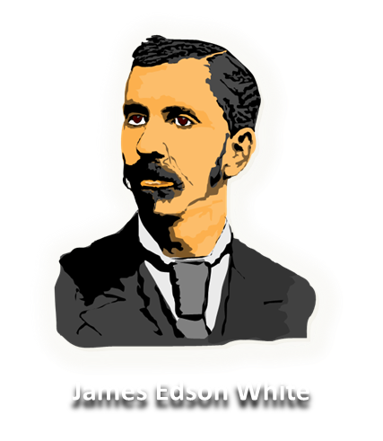

African-American Outreach

Slide 21

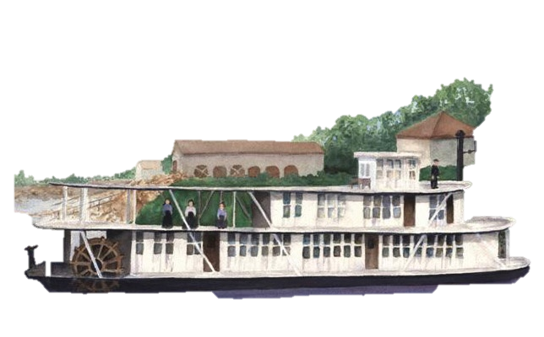
In 1891 Ellen White appealed to church leaders to begin educational and evangelistic work on behalf of the Black race in America's South.
Three years later, one of her sons, James Edson White, built a Mississippi River steamboat and used it for about a decade as a floating mission for Blacks in Mississippi and Tennessee.

Slide 22

Return to
the
United States
(Her last years and death)

Slide 23
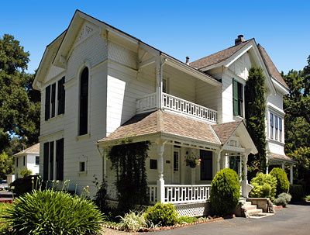
Making her home at Elmshaven,
a few miles
from the rural
town of St. Helena
in northern California,
Ellen White spent
the 15 remaining years
of her life in book
preparation, writing,
personal labor,
and travel.

Slide 24
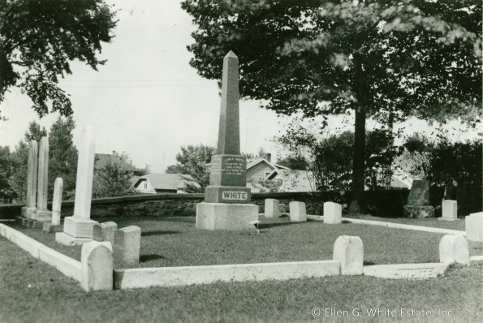
The life of
Ellen White
ended
July 16, 1915,
at the age of 87 years.
She was laid to rest
at the side of her husband
in Oak Hill Cemetery,
Battle Creek, Michigan.

Slide 25
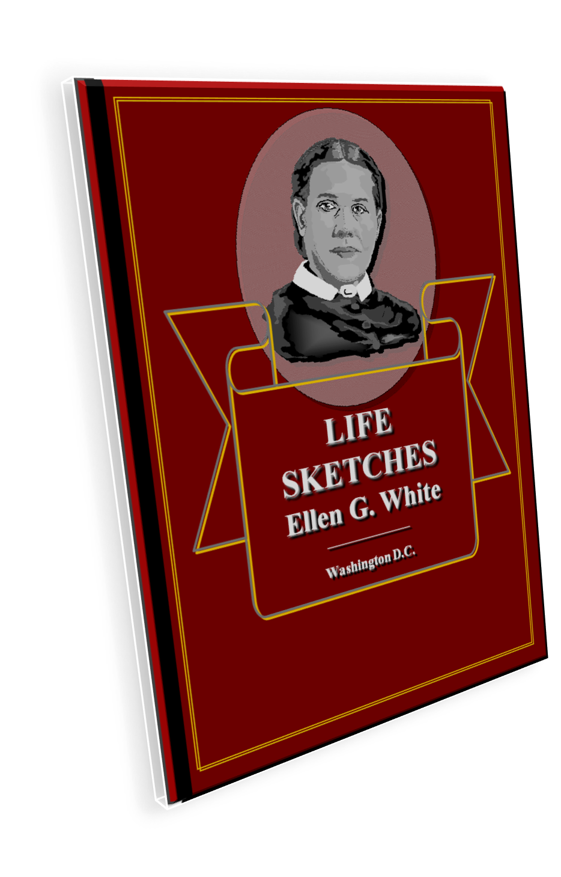
In her book
"Life Sketches"
you can read her complete biography.
FREE ONLINE :
http://temcat.com/L-3-SOP-Library/Orig%26Early/LS15.pdf

Slide 26

We hope we have been able to show you something
more about
the Life
of Ellen G. White…
Ellen G. White
(1827-1915)

Slide 27
END OF PART 3

